Slide 1



DSA TOPIC 1
Home
About us
Startegy
Contact
Finding
Paths in HUST
Members:
Lương Sơn Tùng – 20233944
Bùi Nguyên Vũ – 20224352
Ngô Quang Vinh – 20233946
Instructor: PGS. TS. Trần Thị Thanh Hải
Page 01

Slide 2
Contents
1
2
3
4
5
PART 1
PART 2
PART 3
PART 4
PART 5
Topic Overview
Data structure
Algorithms and Implementations
Dataset and
Experiment
Conclusion
.
Page 02

Slide 3
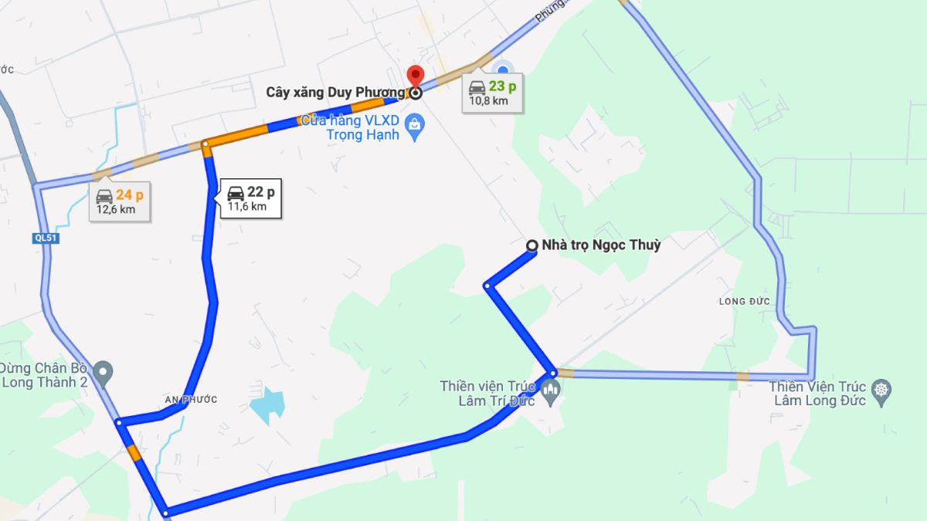

Topic Overview
Main task
Find and display the shortest walking route between 2 chosen points on the HUST campus using Dijkstra’s algorithm and Google Maps.
Applications
Allow new students or visitors to quickly find the shortest walking path between buildings, improving orientation and reducing time spent wandering.
More understanding about Dijkstra Algorithms.
Page 03

Slide 4
Topic Overview
Input/Output
+) Input: A click on the map to pick a starting point. A second click on the map to pick a destination.
+) Output: Display the shortest path from starting point to the destination, and average time to go there.
Page 04

Slide 5
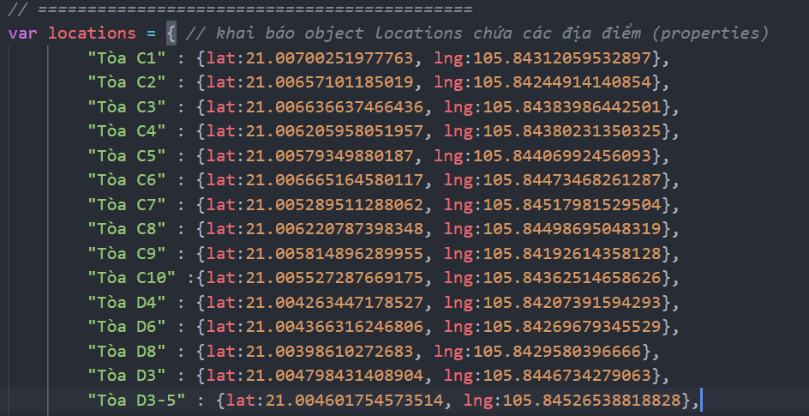
Data Structure
Coordinates List ( locations )
Data type: JSON object.
List of vertex (nodes) in the graph.
Main function: Save geographic coordinates (latitude, longitude).
Number of locations is based on how large the area is (>100 vertex).
Page 05

Slide 6
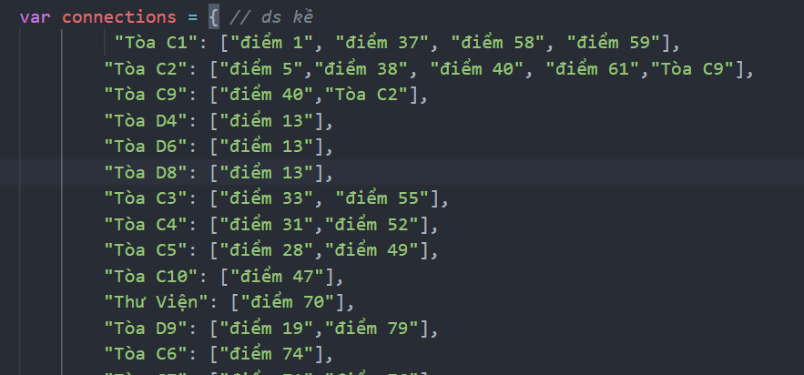
Data Structure
b) Adjacent List ( connections )
Data type: JSON object.
Main function: Save the adjacent vertex (neighbors) of each vertex (nodes).
Data structure to represent Graph on computers.
Each node has around 2-5 adjacent neighbors to make sure every path is covered.
Page 06

Slide 7
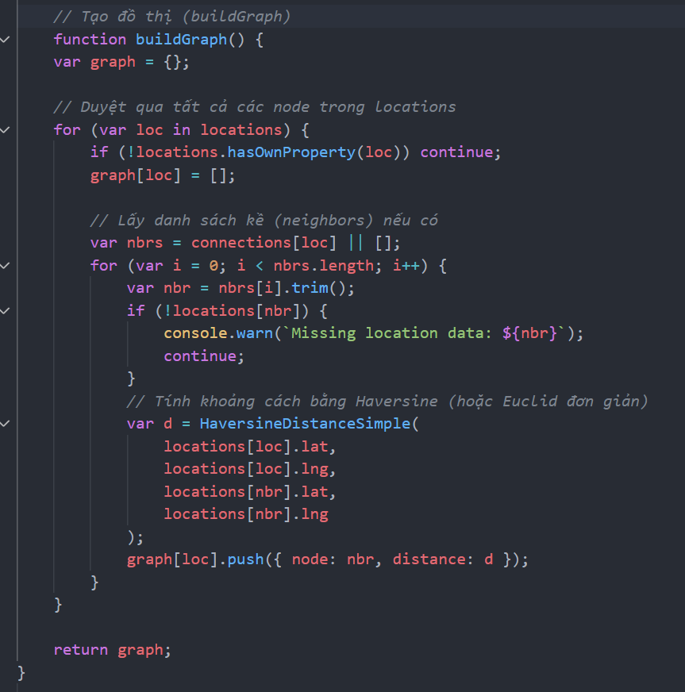
Data Structure
c) Graph ( buildGraph )
Data type: JSON object
var graph = {}; ( declare a object)
Main function: Build a graph consists of each vertex and its adjacent node and distance ( weights).
Graph = {
“Tòa C1”: [{điểm 1,64.2}, … ];
Weighted Graph, basis for Dijkstra’s Algorithm.
Algorithm Complexity: O(V+E), whereas V is vertex, E edges.
Page 07

Slide 8
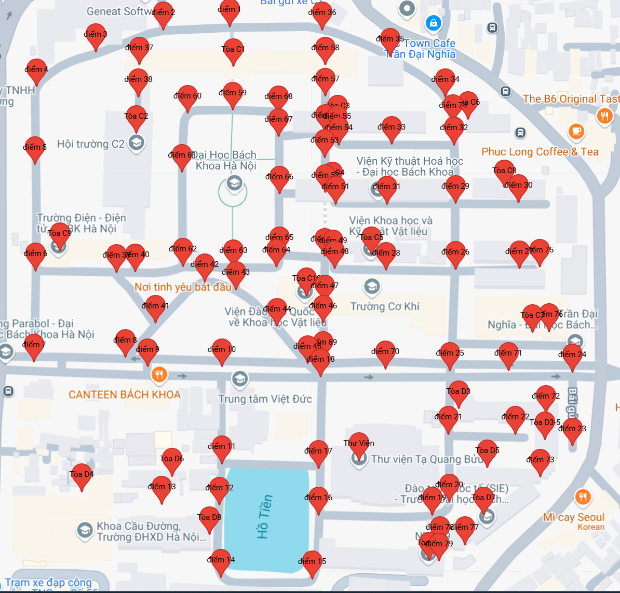
Data Structure

Slide 9
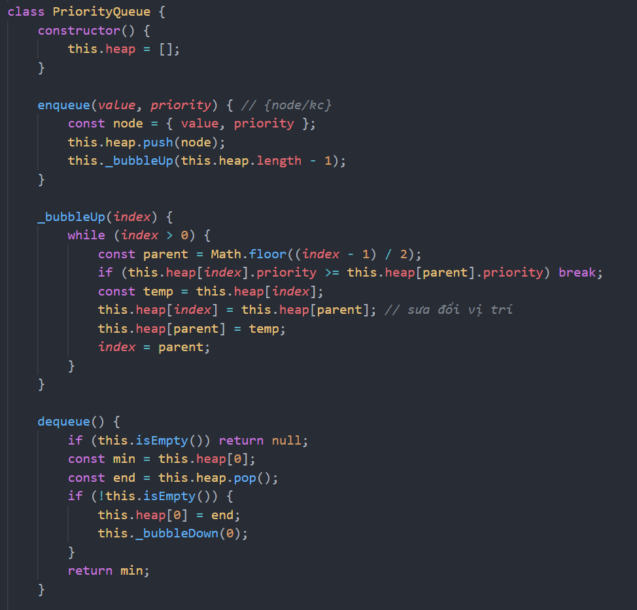
Data Structure
d) Queue ( Priority Queue )
Data type: Class.
Main function: Help Dijkstra’s Algorithms always choose the node with smallest distance.
Based on Min-Heap algorithm,
value at the top( dequeue) always be minimum ( distances)
Page 09

Slide 10
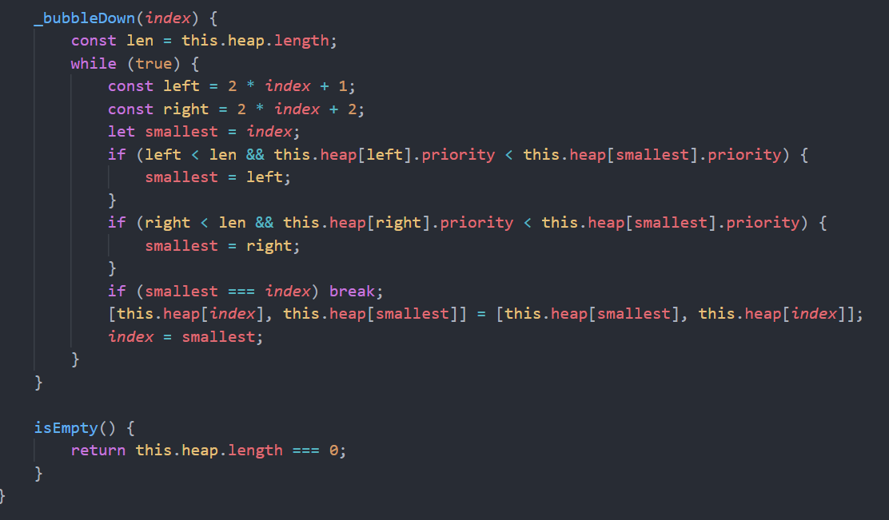
Data Structure
d) Queue ( Priority Queue )
Data type: Class.
Main function: Help Dijkstra’s Algorithms always choose the node with smallest distance.
Based on Min-Heap algorithm,
value at the top( dequeue) always be minimum ( distances)
Page 10

Slide 11


Algorithms and Implementation
Dijkstra’s Algorithm: Determine the shortest path from source node to all others node on the non-negative weighted graph
Modelize the problem:
+) Locations on the map = nodes
+) Edges = distance from one to another location. ( Harvesine Formula)
Page 11

Slide 12
Algorithms and Implementation
Implementations
Build graph from Coordinates List (locations) and Adjacent List. (connections)
Calculate the distances of each nodes using Harvesine formula.
Apply Dijsktra’s Algorithms.
Using Google Map API to display map on the web.
Page 12

Slide 13
Algorithms and Implementation
Build graph from Coordinates List (locations) and Adjacent List. (connections)
Declare new object graph contains all the nodes and its adjacent node and distances.
Graph = {
“Tòa C1”: [{điểm 1,64.2}, … ];
Travel through all nodes in locations
Connect each node to its neighbors from connections by calculating the distance between them. ( Harvesine)
Page 13

Slide 14
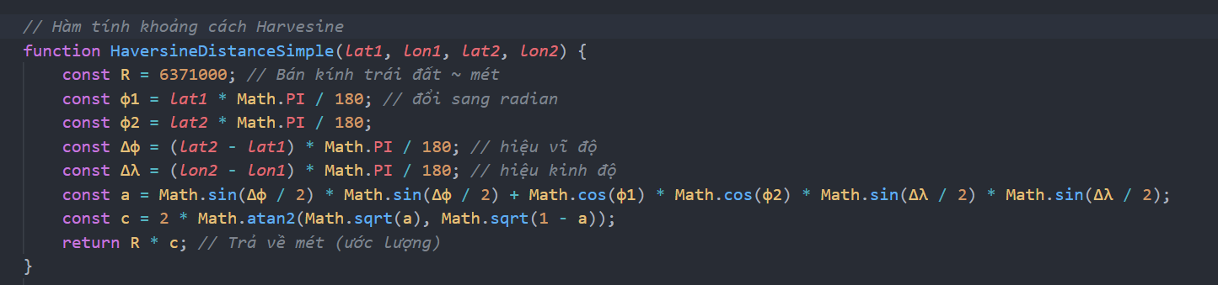
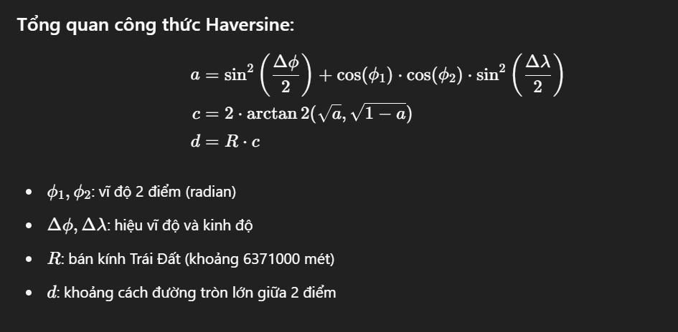
Algorithms and Implementation
2. Calculate the distances of each nodes using Harvesine formula.
Page 14

Slide 15
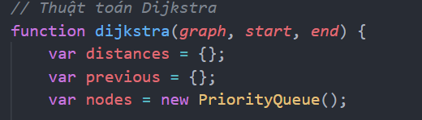
Algorithms and Implementation
Apply Dijkstra’s Algorithm
Main data structures used:
distances: Declare the shortest distance from starting node to all other nodes.
Previous: save the previous node to get the current shortest distance.
PriorityQueue: always choose the node with minimum distance to be at the top queue.
Page 15

Slide 16
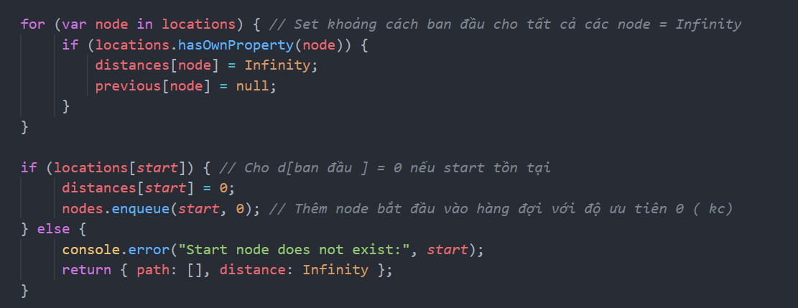
Algorithms and Implementation
Apply Dijkstra’s Algorithm
- Let distance from starting node to other nodes = Inf,
d[start] = 0, previous of all nodes be null.
Add start node {node,0} to the queue.
When we dequeue, we calculate distances to the neighbor around the node has just taken out, and put the neighbor node {neighbor, d} all in the queue
Page 16

Slide 17
Algorithms and Implementation
Apply Dijkstra’s Algorithm
To easy to understand, the distances and previous will look like this at the beginning.
Distances = {
“Tòa C1” = 0,
“điểm 1” = inf,
…,
};
Similar to previous
Page 17

Slide 18






Algorithms and Implementation
Apply Dijkstra’s Algorithm
- Let distance from starting node to other nodes = Inf,
d[start] = 0, previous of all nodes be null.
Add start node {node,0} to the queue.
When we dequeue, we calculate distances to the neighbor around the node has just taken out, and put the neighbor node {neighbor, d} all in the queue
Page 18

Slide 19
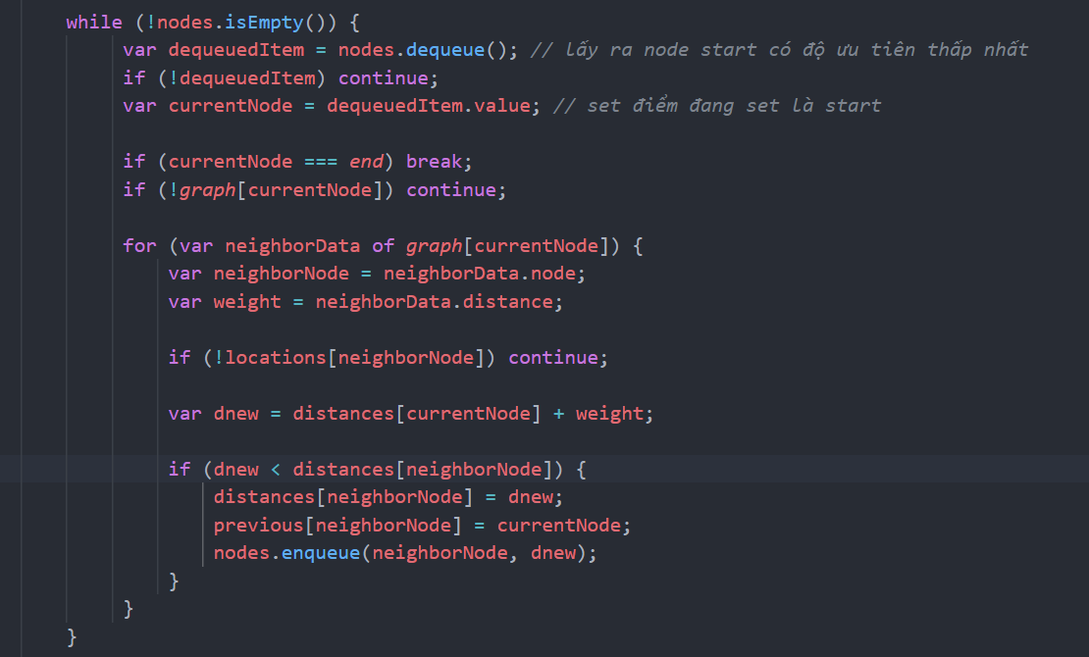
Algorithms and Implementation
3. Apply Dijkstra’s Algorithm
Update the distances by
dnew = distances[currentNode] + weight
If dnew < old distance:
+) Update new distance
+) Update previous path
+) Put the neighbor node into the queue and loop it all again.
This is the same as d[v] = min(d[v], d[u]+ (u,v)).
For example:
Starting node = {node = “Tòa C1”, distances = 0}
Node “Tòa C1” is adjacent with “1” with 14m,
dnew = d[“1”] + 14 = 14m
And update d[“1”] is now 14m.
Previous of “1” is “Tòa C1”.
Page 19

Slide 20
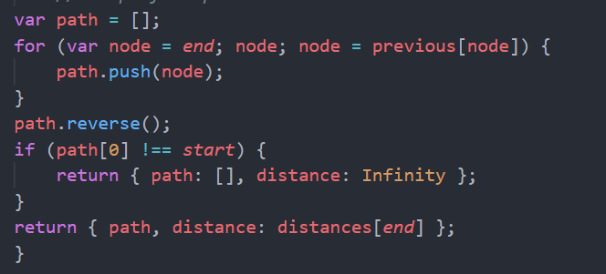
Algorithms and Implementation
Apply Dijkstra’s Algorithm
Finally, after we find the shortest distances from starting node to end node, we need the steps ( path) of it.
Declare a array path contains nodes from previous data structure.
- And return the path and distance to the end node.

Slide 21
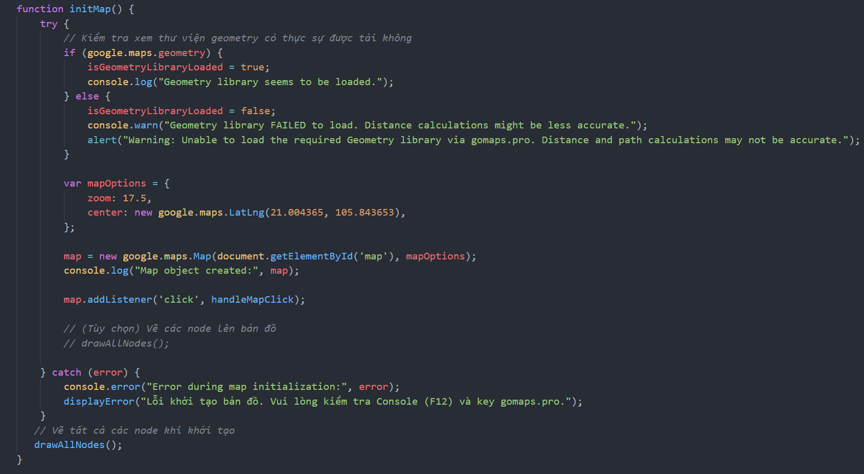
Algorithms and Implementation
4. Using Google Map API to display map on the web.

Slide 22
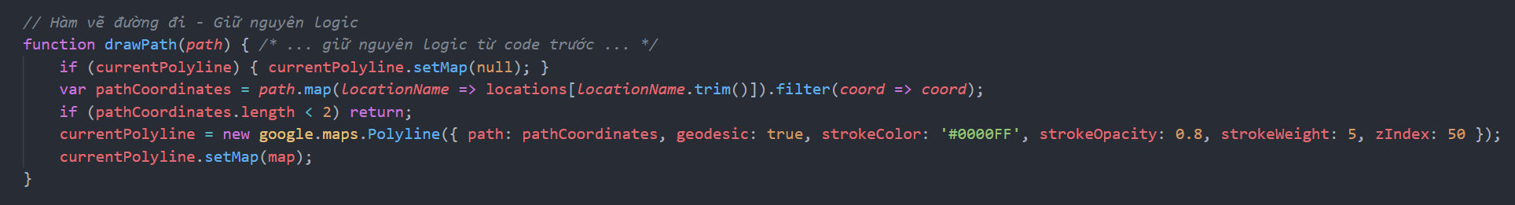
Algorithms and Implementation
4. Draw path

Slide 23


Dataset and Experiment
Programming Languages:
HTML, Javascript
Library:
+) Google Maps API: display map
+) HTML/CSS: user interface
+) Javascript: handle algorithms and mathematics.
Page 02

Slide 24

Dataset and Experiment
Experiment:
Input: Choose the starting point ( green dot appear), and choose the end point.
Output: Display the shortest path and distance, step by step, and average time for person with velocity 4.8km/h.
Page 02

Slide 25
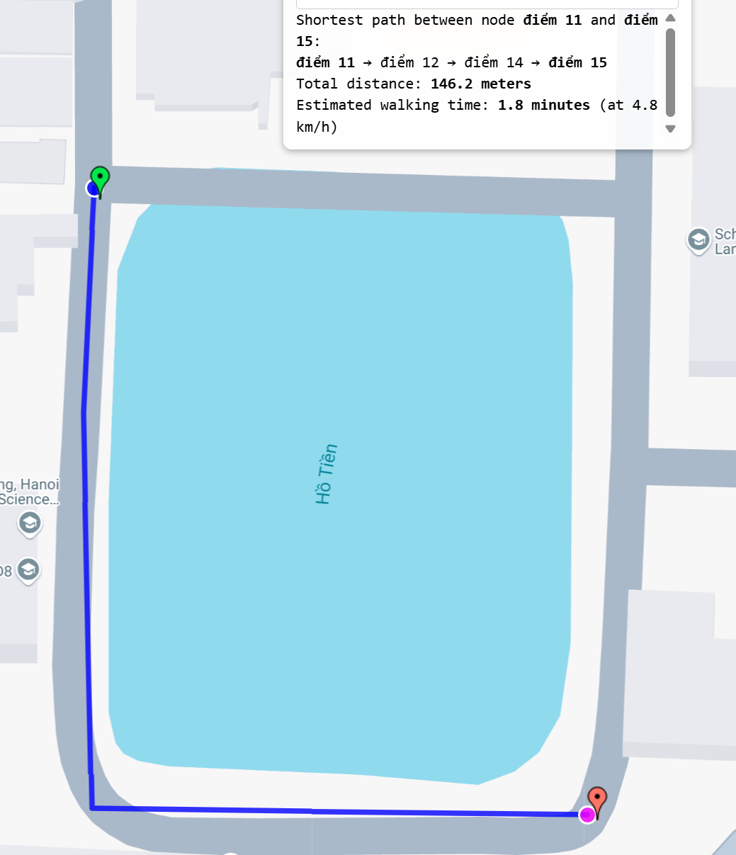
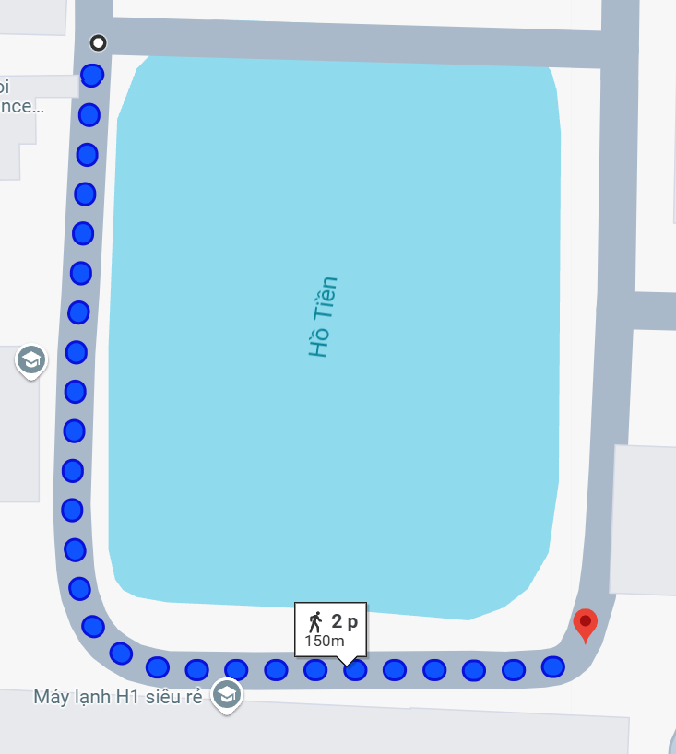
Dataset and Experiment
Our project
Google Map

Slide 26
Conclusion and Limitations
This project successfully implements an interactive shortest path finder on the HUST campus map using Dijkstra’s algorithm.
It provides users with an intuitive interface to select start and end points and visualizes the shortest route effectively.
The integration with Google Maps enhances user experience by leveraging accurate geographic data and dynamic map rendering.
Page 02

Slide 27
Conclusion and Limitations
Difficulties:
+) Learning Javascript/HTML.
Limitations:
+) The UI could be further improved for accessibility and additional user feedback.
Future improve:
+) Enhance interface for users.
+) Algorithms and data structure optimal
Page 02

Slide 28
Thank
You.
Thank
You.
Thank
You.

